Slide 1
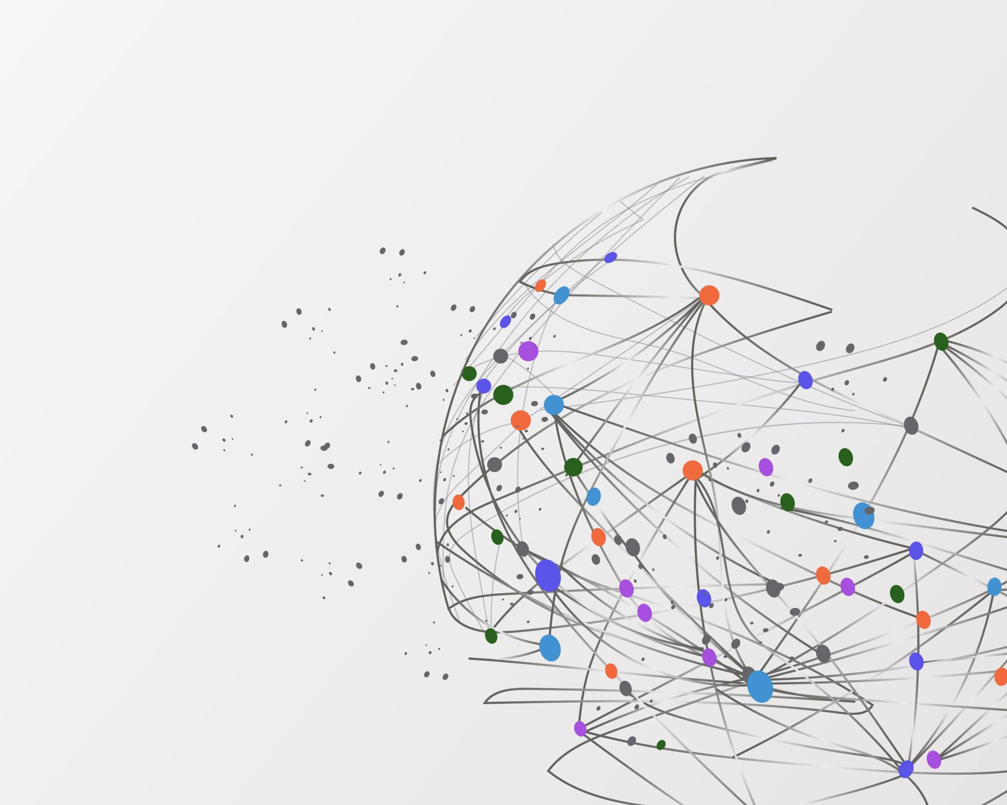

Biweekly Progress
Customer Lifetime Value Prediction
Shashwat Dhayade

Slide 2
Planned vs Completed/Pending
PLANNED
Finish Data Cleaning
Categorize Monetary Variable
Feature Engineering
RF Model
PCA
NN Model
Completed
Finish Data Cleaning
Feature Engineering for understanding extremes
Correlation Matrix
RF Model
PCA
NN Model
Pending
Categorize Monetary Variable
Understanding extremes in my dataset

Slide 3
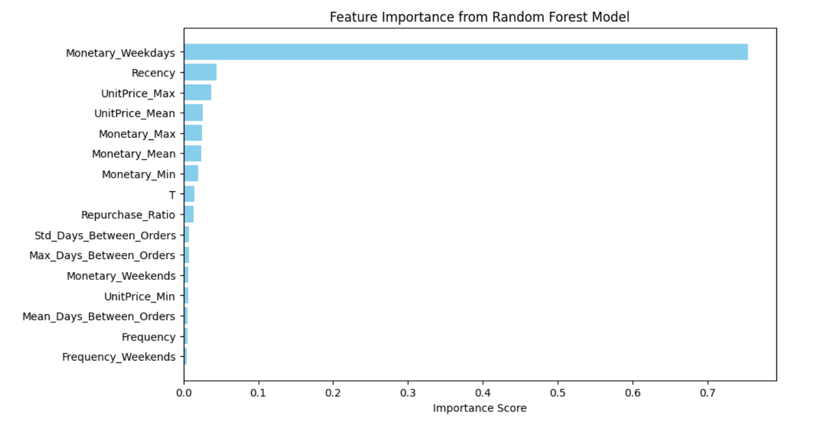
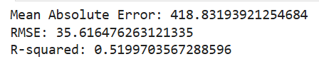
Process
Dropped Duplicates
Dropped POSTAGE (Online Source)
Split the data into 70-15-15

Slide 4
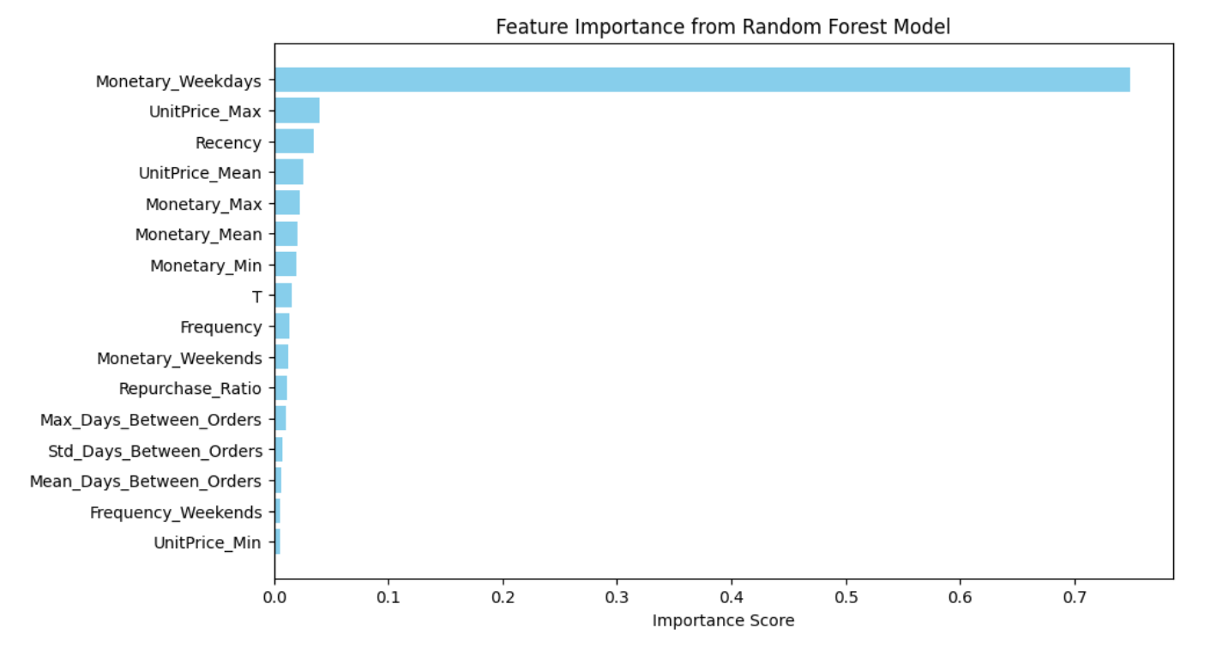
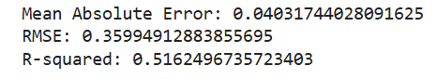
Scaling

Slide 5
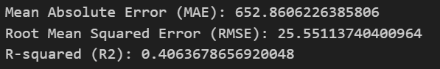
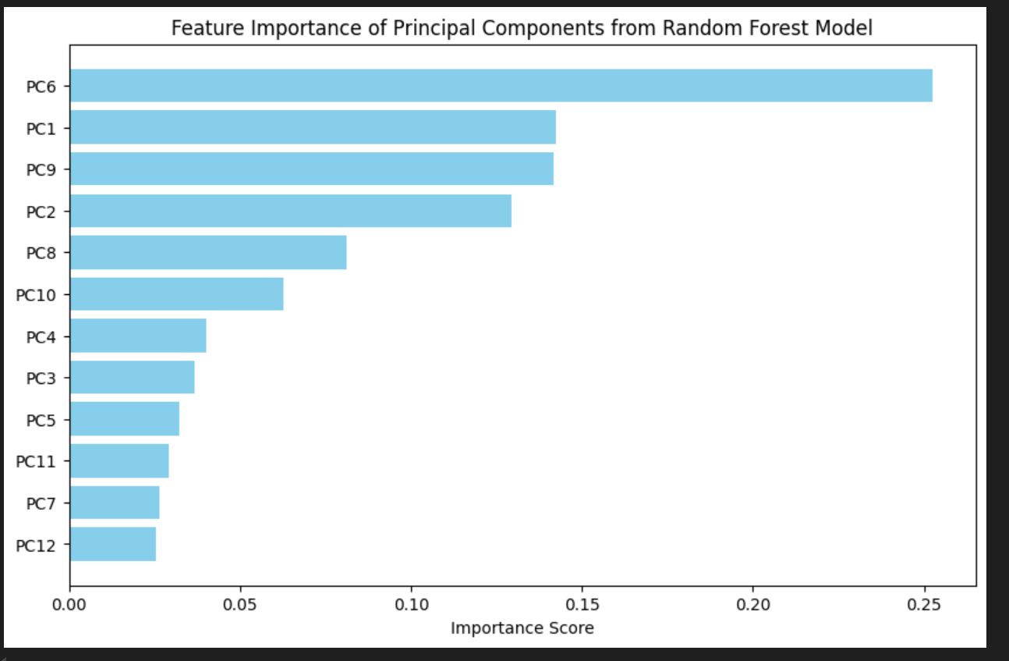
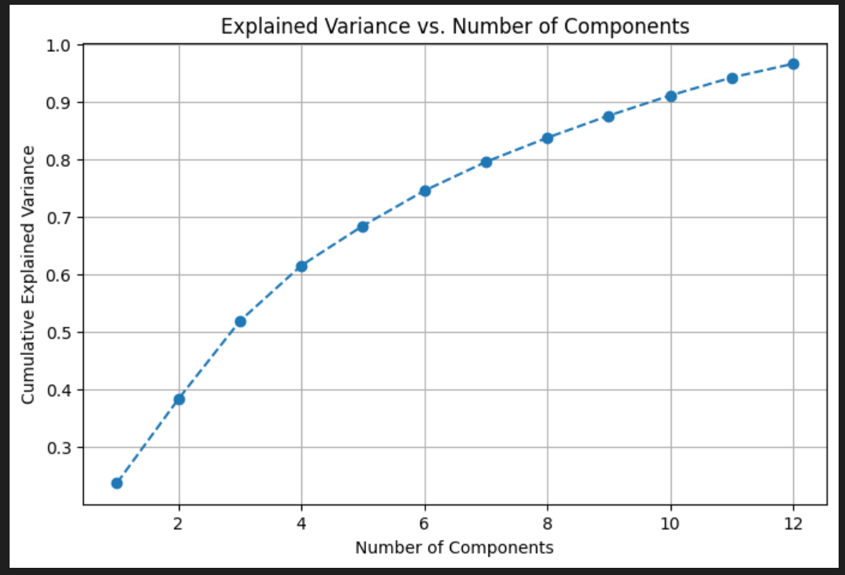
PCA

Slide 6
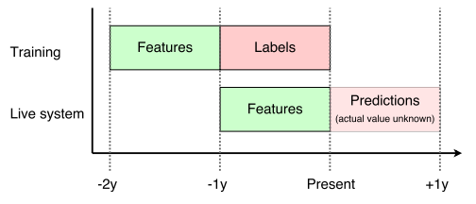
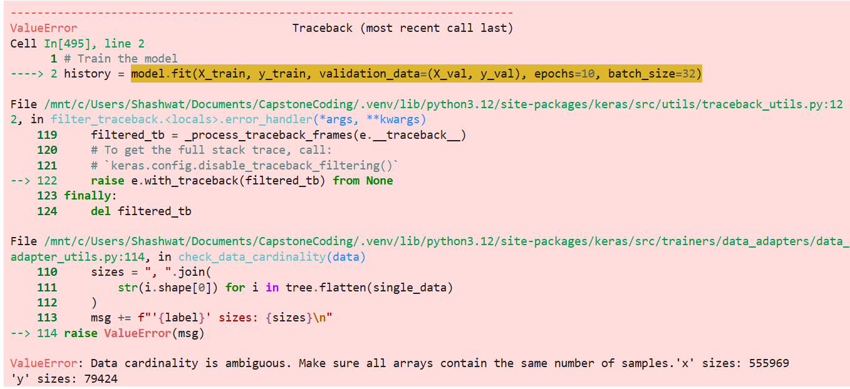
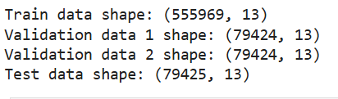
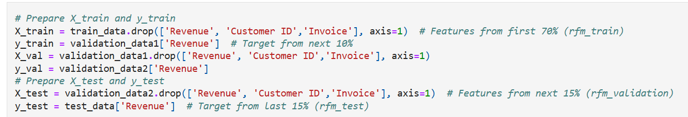
NN Model

Slide 7
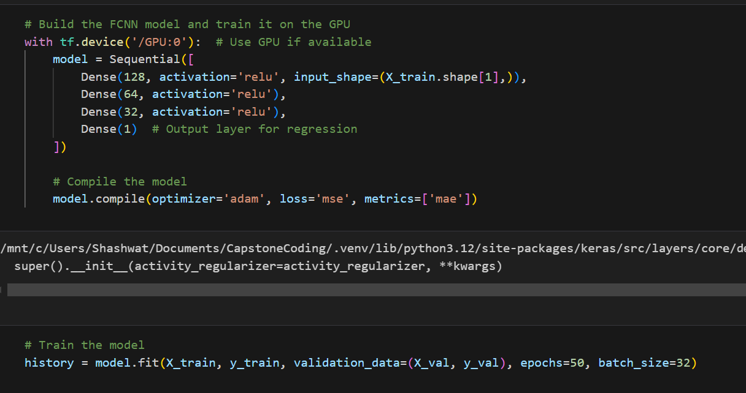
NN Model

Slide 8
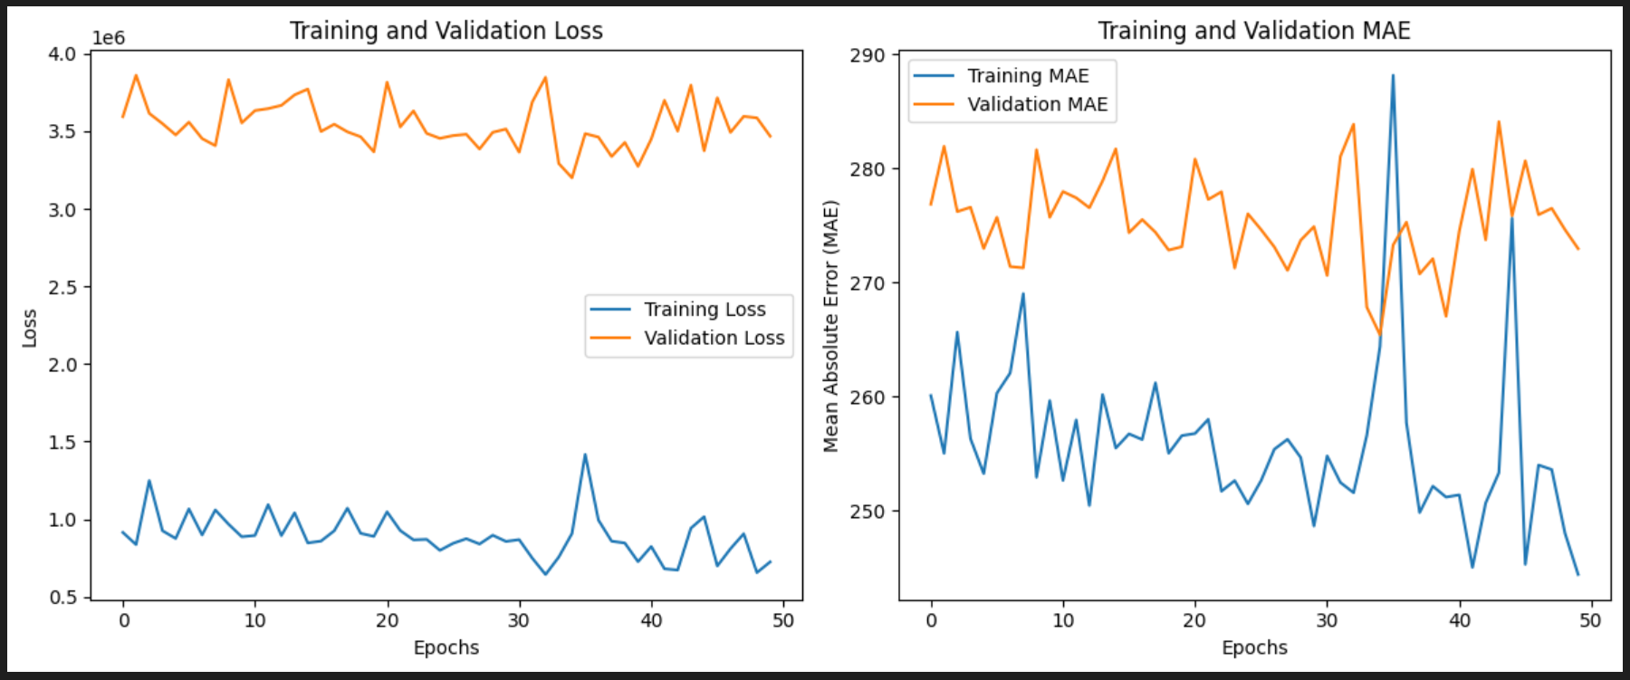

Slide 9
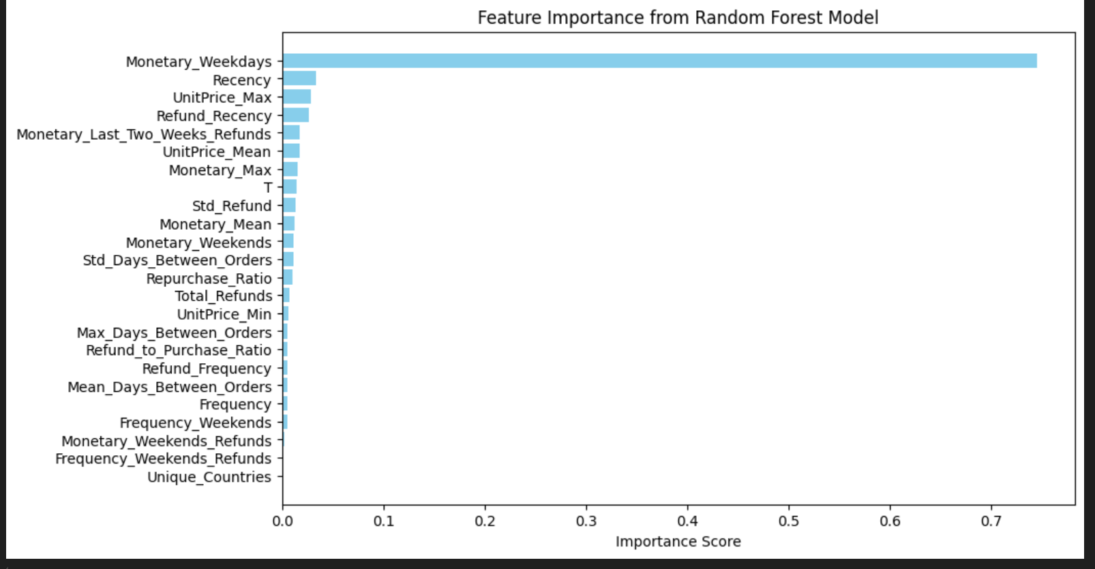
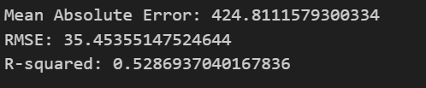
Refund Features – RF Model

Slide 10
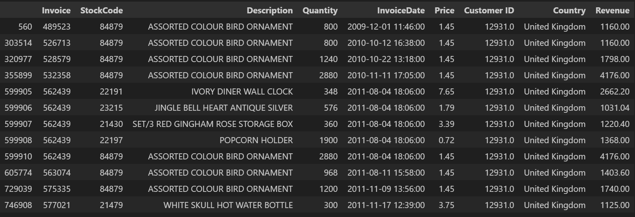
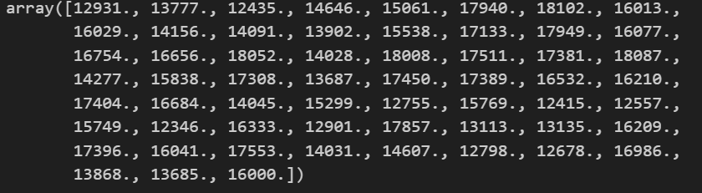
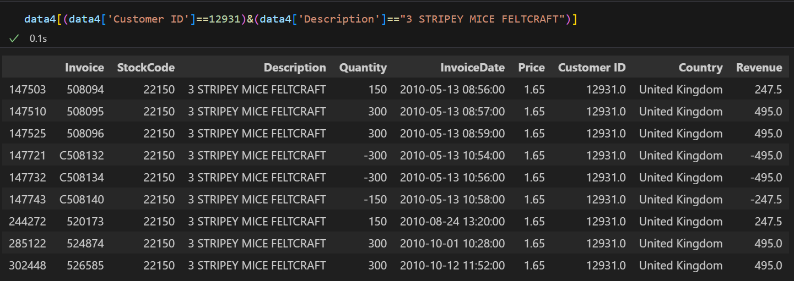
Extreme / Unusual Data
Without Feature Extraction

Slide 11
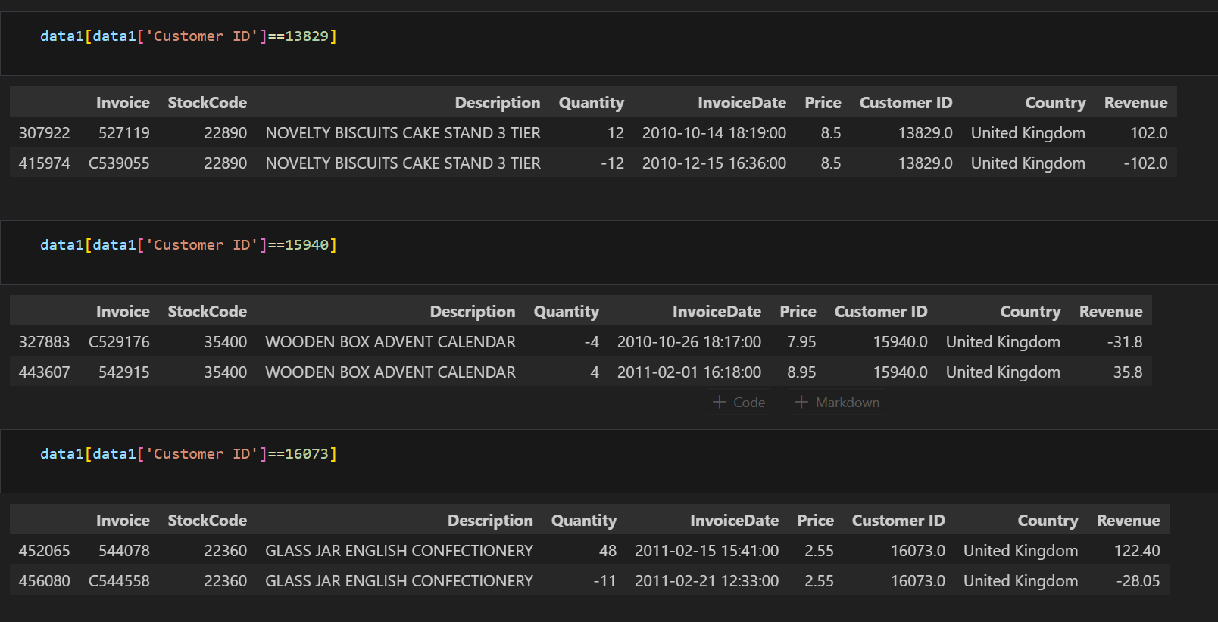

Slide 12
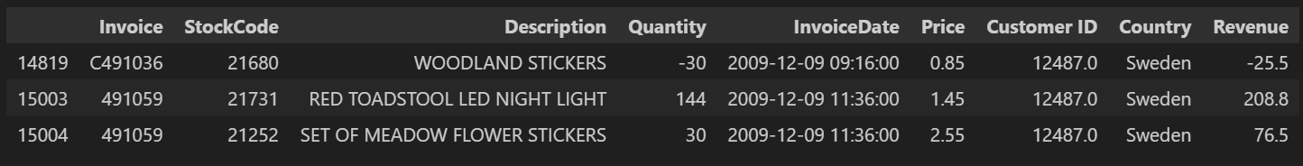
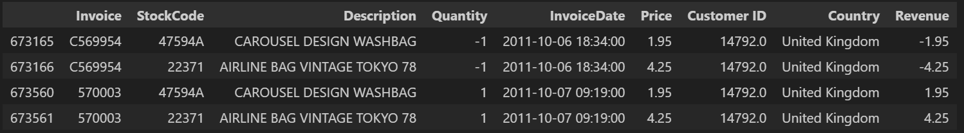
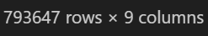

Slide 13
Feature Engineering
Split positive and negative data
'Frequency_Weekdays_Refunds',
'Monetary_Weekdays_Refunds',
'Quantity_Weekdays_Refunds',
'Frequency_Weekends_Refunds',
'Monetary_Weekends_Refunds',
'Quantity_Weekends_Refunds',
'Refund_Recency',
'Refund_Monetary_Mean',
'Refund_Monetary_Sum',
'Refund_Monetary_Min',
'Refund_Monetary_Max',
'Refund_Unique_Items',
'Total_Price_Sum',
'Total_Quantity',
'Unique_Countries',
'Quantity_First_Two_Weeks',
'Quantity_Last_Two_Weeks',
'Quantity_Weekdays',
'Refund_Unitprice_Mean',
'refund_unitprice_min',
'refund_unitprice_max',
'refund_unitprice_var',
'refund_total_price_sum',
'refund_total_quantity',
'Discount_Frequency',
'Discount_Monetary_Value',
'Discount_Ratio',
'Discount_Revenue_Ratio',
'Discount_Quantity_Value'
'Quantity_Weekends',
'Refund_Frequency',
'Refund_to_Purchase_Ratio',
'Frequency_First_Two_Weeks_Refunds',
'Monetary_First_Two_Weeks_Refunds',
'Quantity_First_Two_Weeks_Refunds',
'Frequency_Last_Two_Weeks_Refunds',
'Monetary_Last_Two_Weeks_Refunds',
'Quantity_Last_Two_Weeks_Refunds',

Slide 14
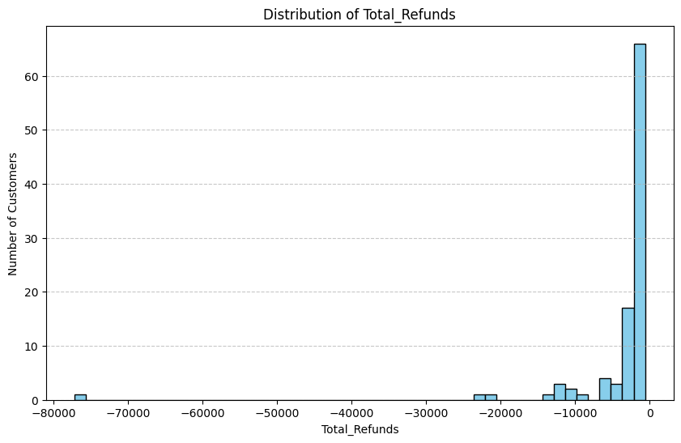
Refund

Slide 15
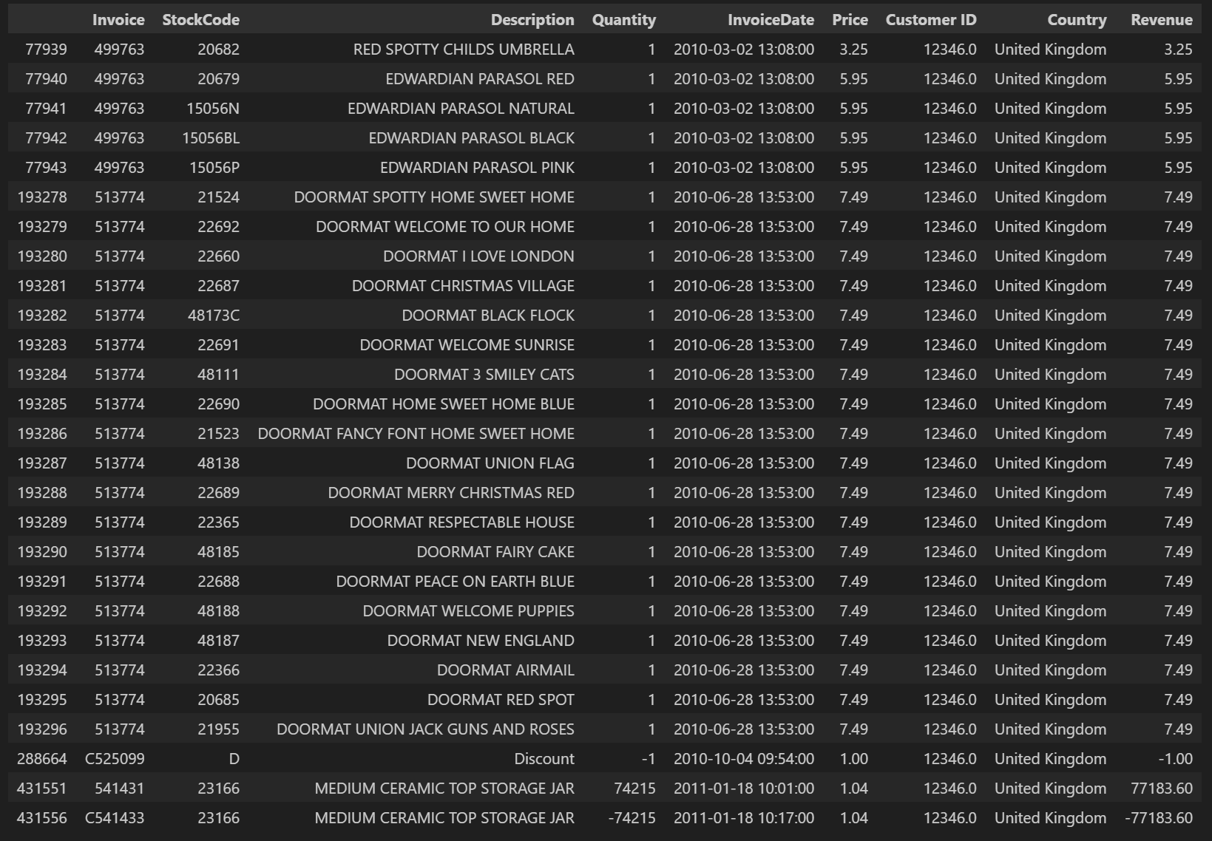

Slide 16
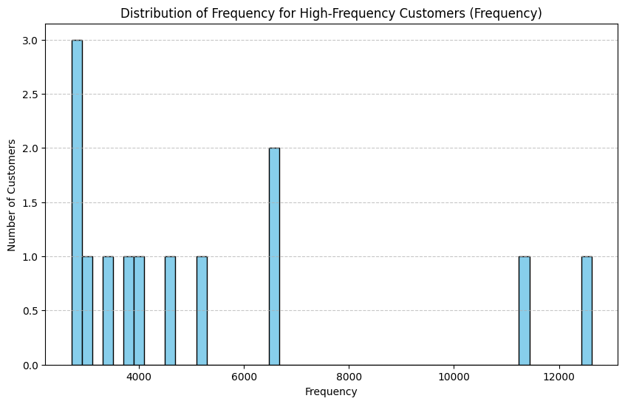
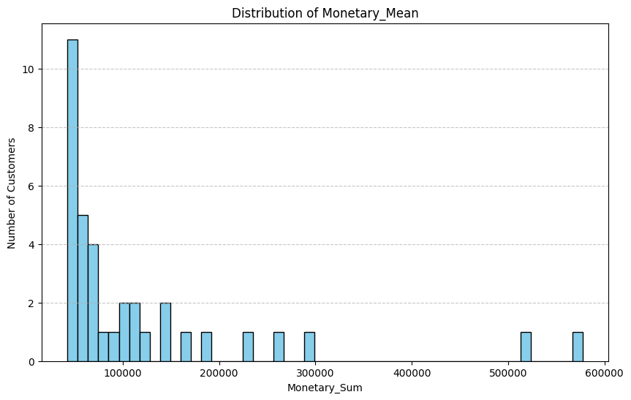
Frequency & Monetary_Sum

Slide 17
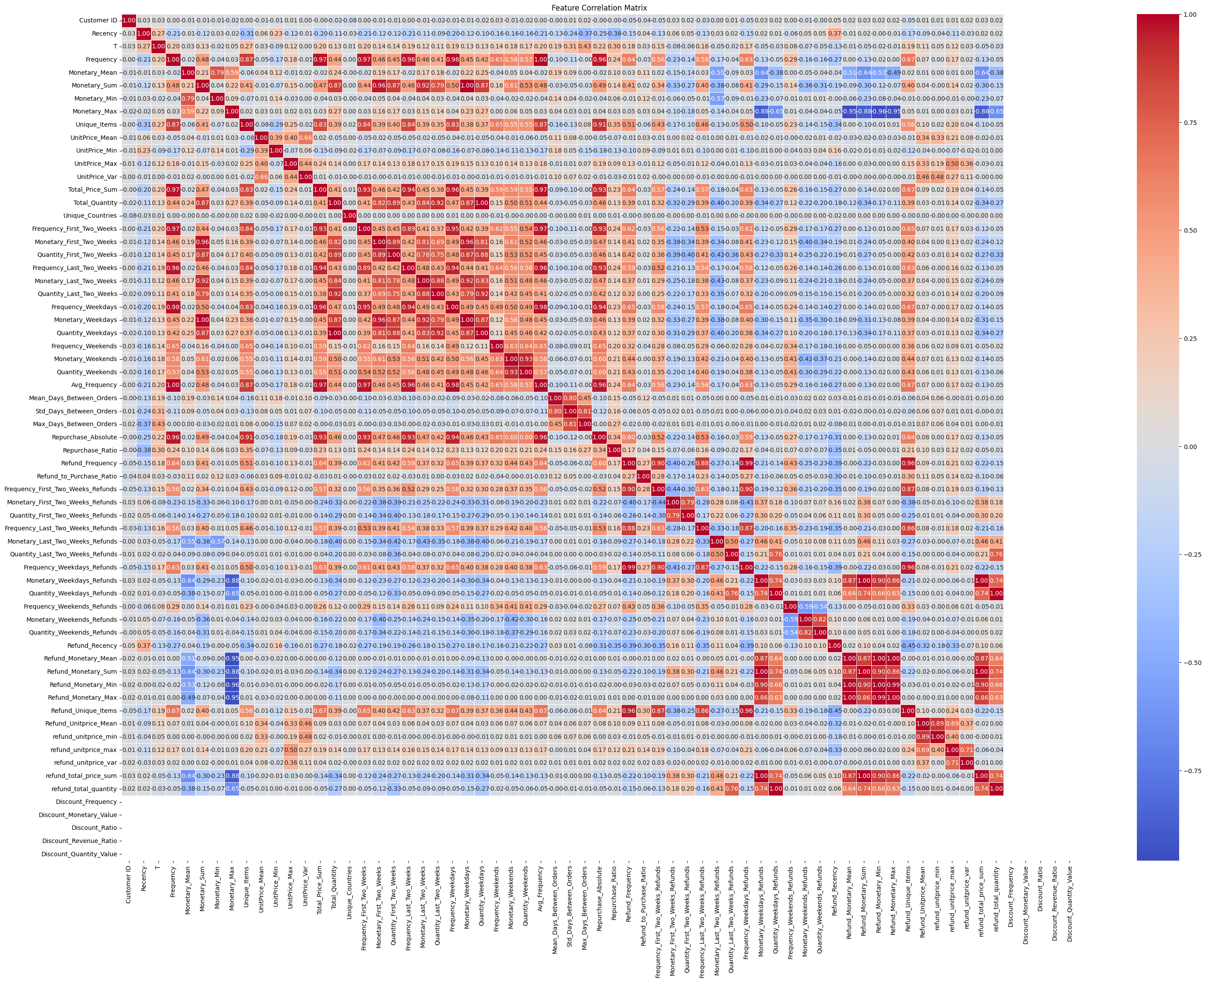
Correlation Matrix

Slide 18
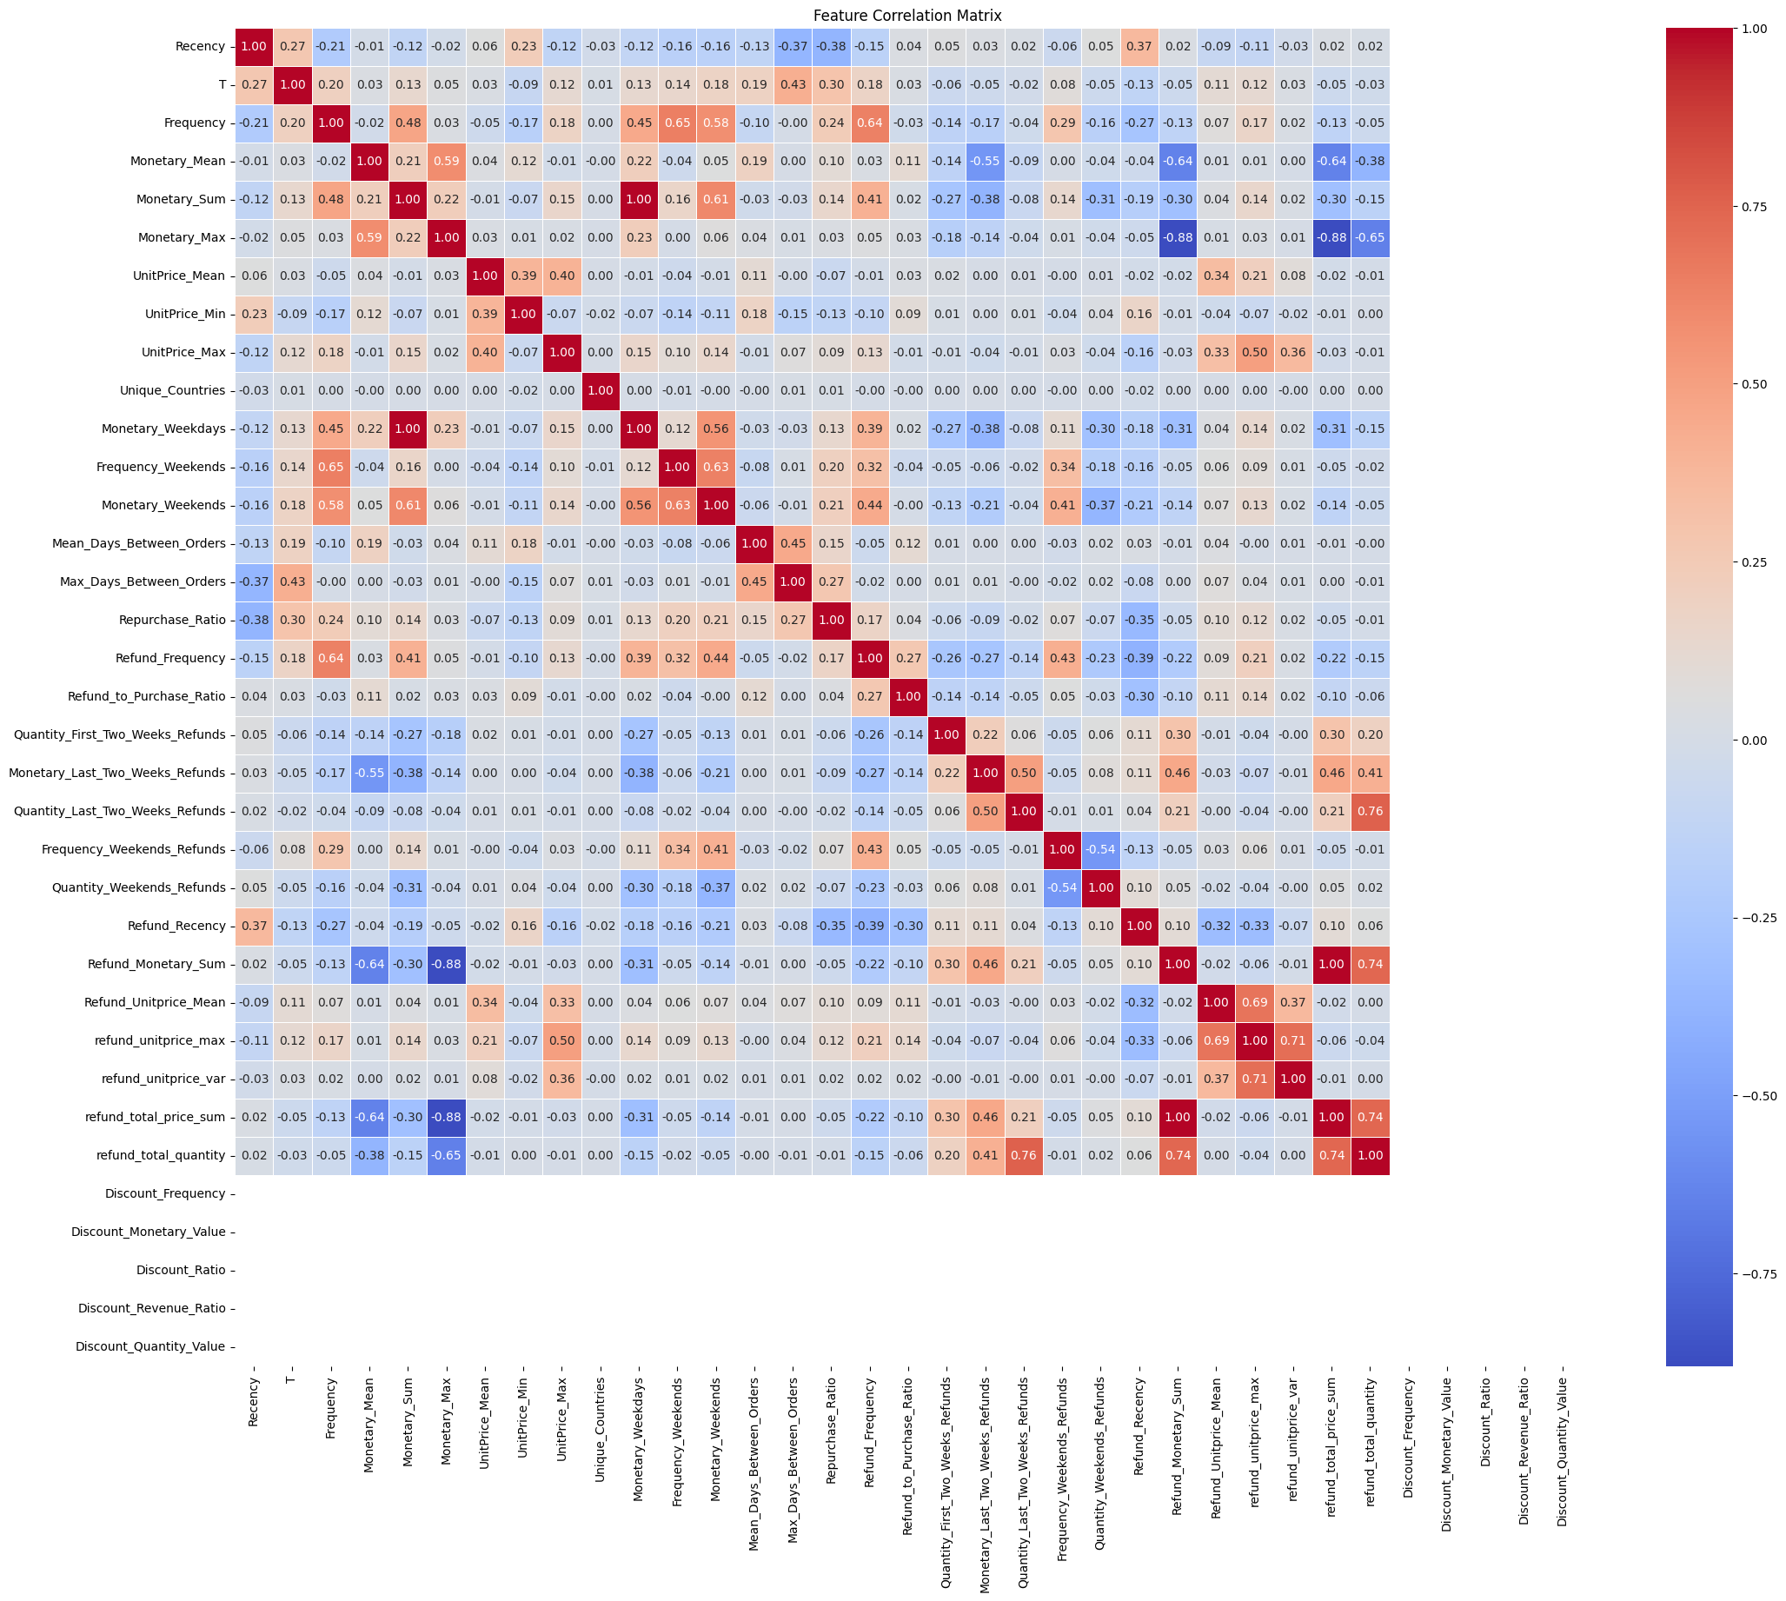
Correlation Matrix

Slide 19
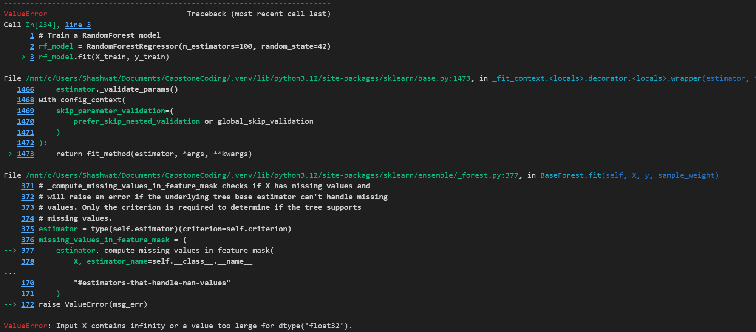
Training Error - RF

Slide 20
Future Plan
Understand Outliers
Modeling
How to include Categorical Variables?
How to include product descriptions / refunds for specific products?

Slide 21
Thank you

